Slide 1
"No Need to Panic, It's All Under Control..." A Visual Critique of European Government’s COVID-19 Response Strategies
Study Group 11

Slide 2
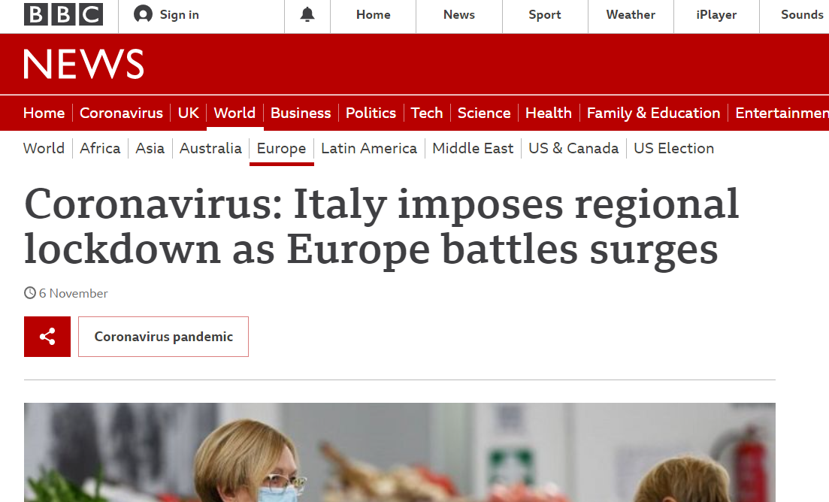
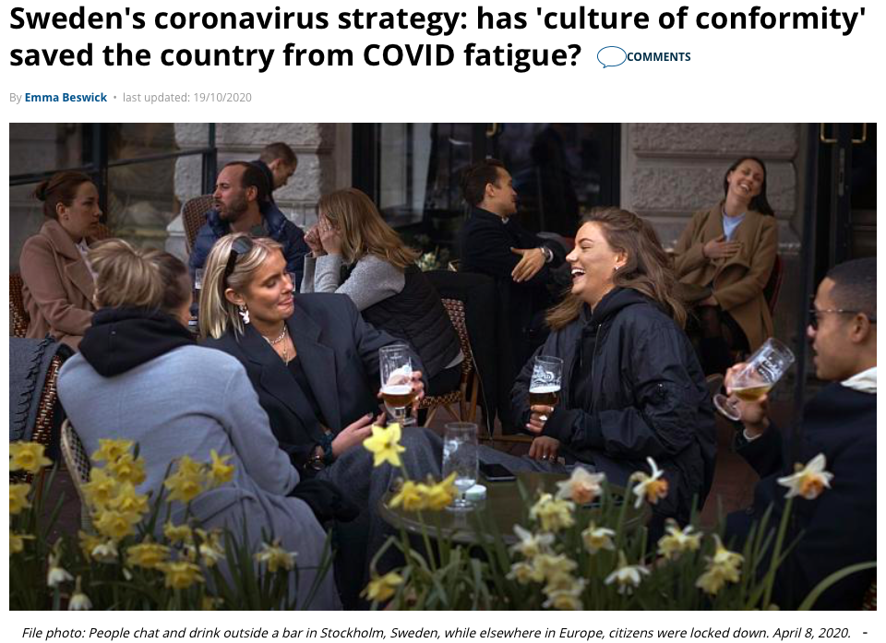
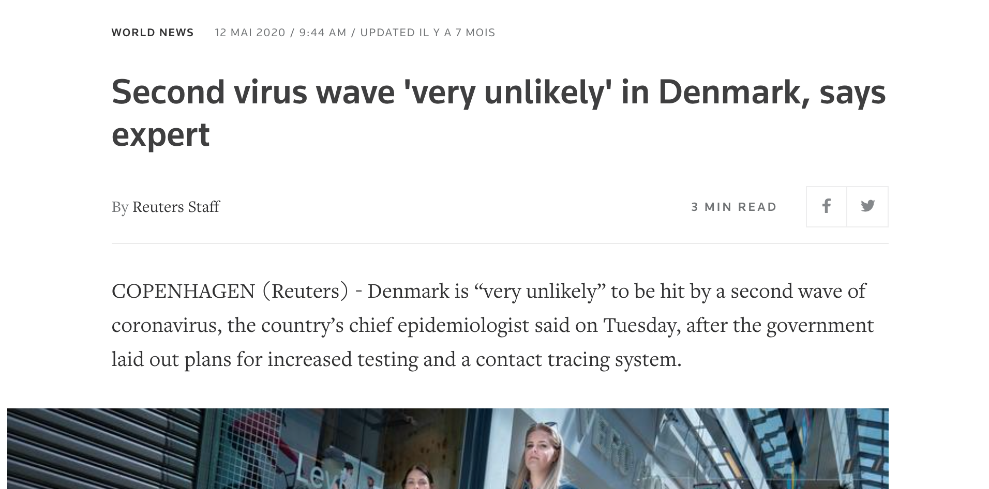
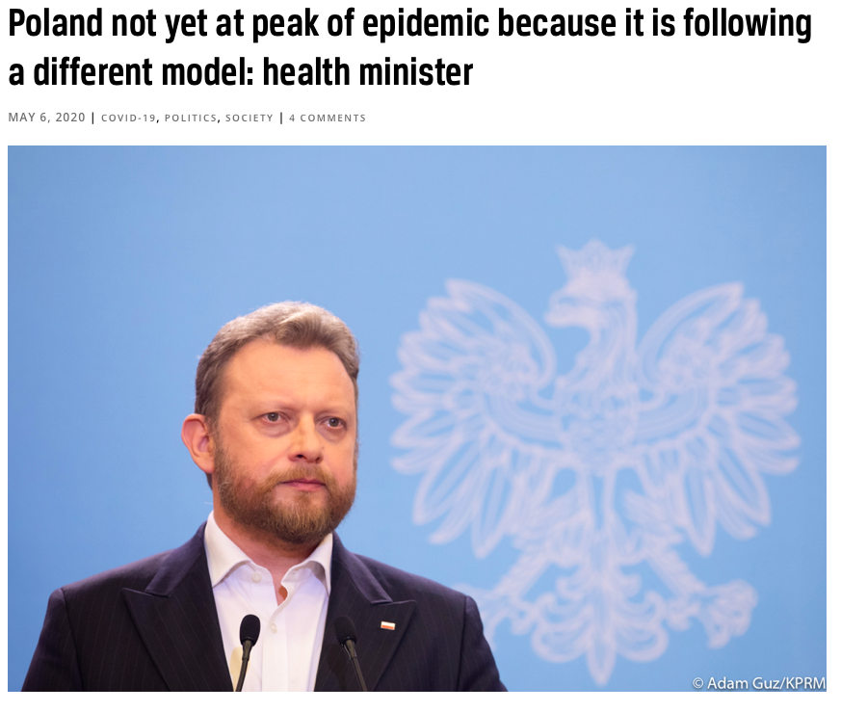
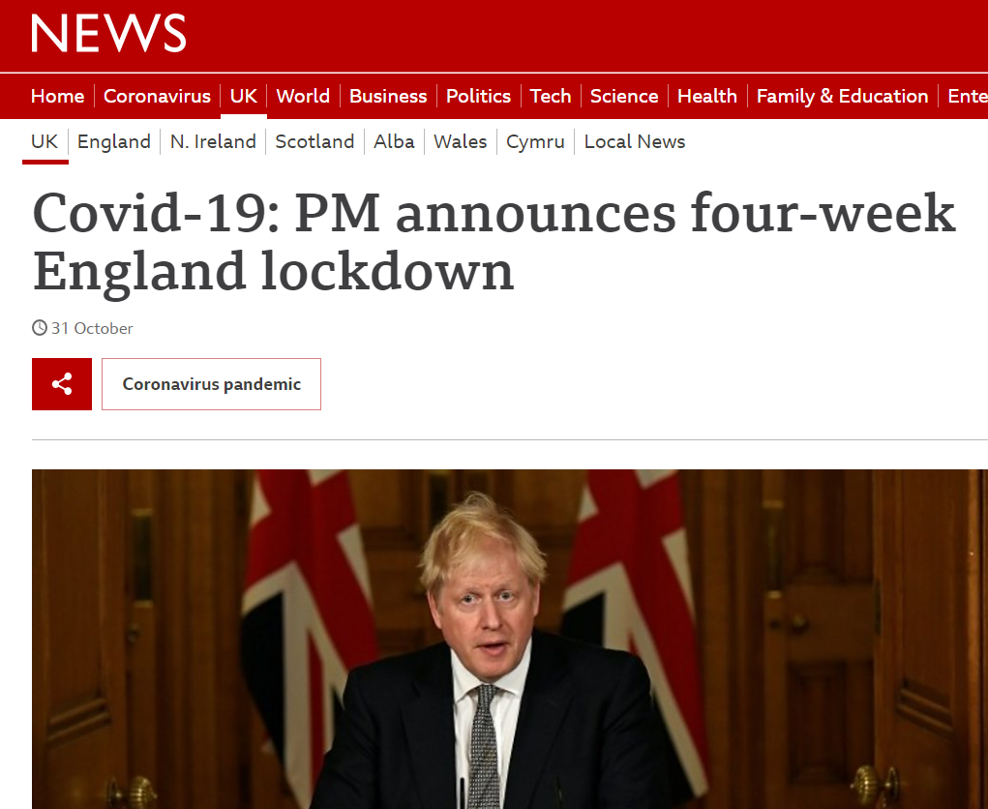
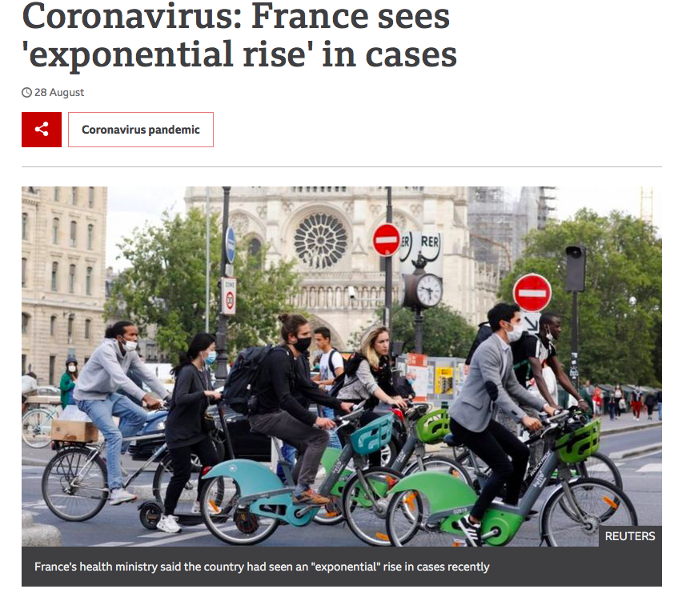
Did you say Lockdown? European governments are taking different measures to fight COVID-19

Slide 3
Do they Really have Everything under Control? We want to understand the differences between COVID - 19 responses amongst European governments and their level of effectiveness
have COVID-19 response strategies been successful?
mitigation strategies have been most effective at combatting the virus?
WHERE
WHAT
factors are most important in determining the success of mitigation strategies?
does the theorised efficacy of mitigation strategies vary between countries?
WHICH
HOW

Slide 4






How Did We Find the Information? We predominantly used Data from Our World In Data and the Oxford CGRT Stringency Index to analyse the effects of Government measures
School & Workplace closures (*2)
1
Our World In Data
Hospital Data
Testing Data
Number of Cases and deaths per country over time
COVID DATA
Cancel public events & Restrictions on gatherings (*2)
Stay at home
The Stringency Index
How to quantify the degree of strictness of the implemented policies?
Restrictions on internal transportation (inc. closing public transportation) (*2)
2
POLICY DATA
International travel controls
Public information campaigns

Slide 5



What was our Methodology? After cleaning and wrangling the data, we analysed trends and searched for patterns
Data Cleaning
Combining 3 datasets: cases/deaths and stringency, hospital data, and testing
Handling of missingness
Selection of variables
Tidying dataset
Creating a subset of Europe
Analyses
Holistic analyses
Selection of countries for deep dive
Deep Dive Analyses
Explanatory Model
Enriching the Dataset
No’ of days since > 100 cases
No’ of days since > 1,000 cases
No’ of days since 0 cases
No’ of days since 0 deaths

Slide 6
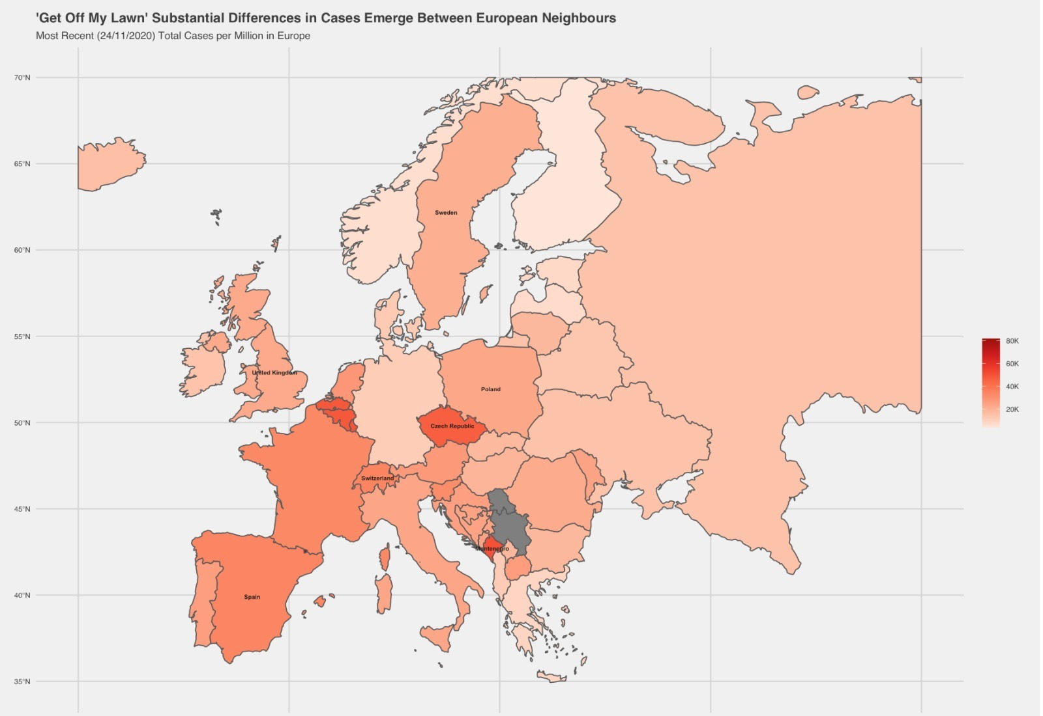
Which European Country has the Most Cases? Selection of countries of interest based on cases per Million and global media coverage
Low number of cases
Denmark: earliest & longest full country lockdown
Norway, Finland, Greece, Netherlands, and Germany
Medium number of cases
Italy: first country hit badly
Poland: severe lockdown and overcorrection
Sweden: no lockdown
United Kingdom: criticized for delayed lockdown Iceland
High number of cases
France: criticized for its ‘chaotic’ policing strategy
Czech Republic, Spain, Luxemburg, Switzerland

Slide 7
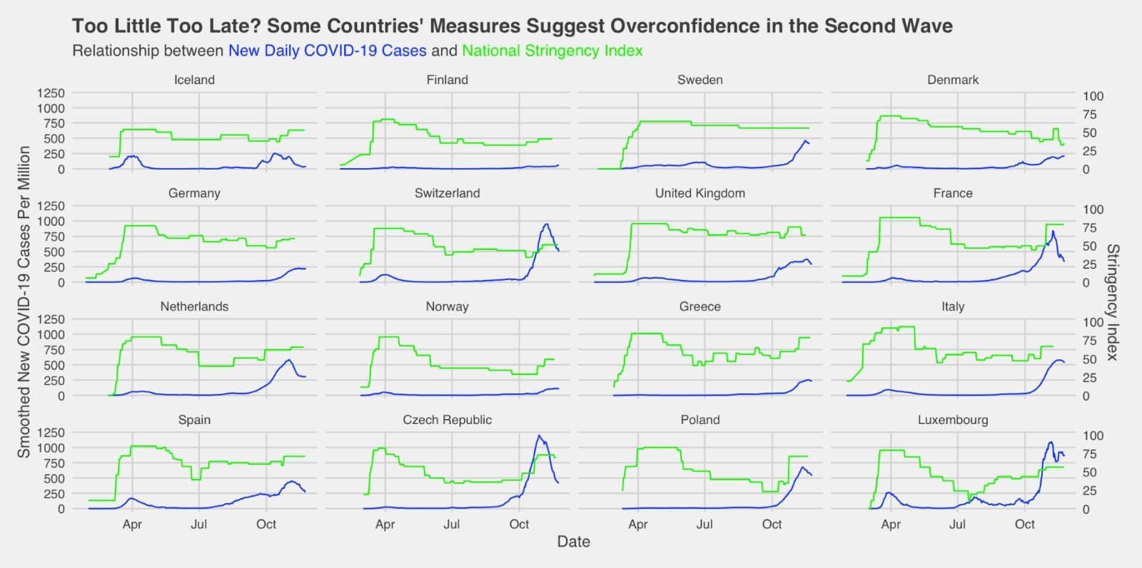
How did the Restrictions Affect the Number of Cases? Three COVID-19 response strategies emerge, with differing success …
Patterns in measures and their effects
Stable measures
Relatively low changes in number of cases for Finland and Denmark
Medium variance over time
High peak in second wave for Switzerland, France and the Netherlands
Germany, Norway, Greece able to contain few cases
High variance over time
High peak in second wave for Czech Republic, Poland and Luxembourg

Slide 8
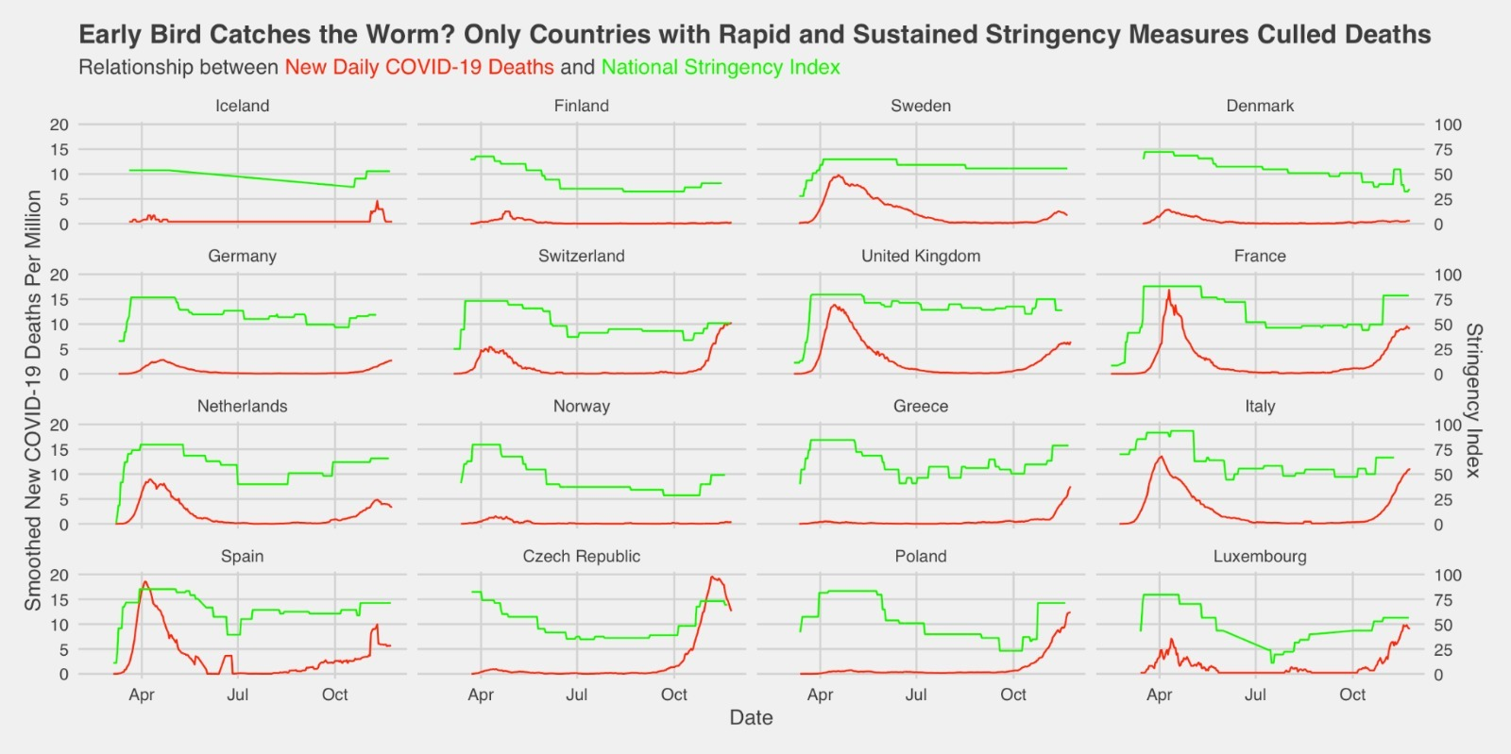
How did the Restrictions Affect the Number of Deaths? …but high early deaths suggest low number of cases might result from a lack of testing during the first wave
Patterns in measures and their effects
Stable measures
Besides Sweden, low number of deaths
Medium variance over time
Compared to cases, high number of deaths during first wave
Only Germany, Norway, Greece able to contain deaths
High variance over time
High peak in second wave for Czech Republic, Poland and Luxembourg

Slide 9
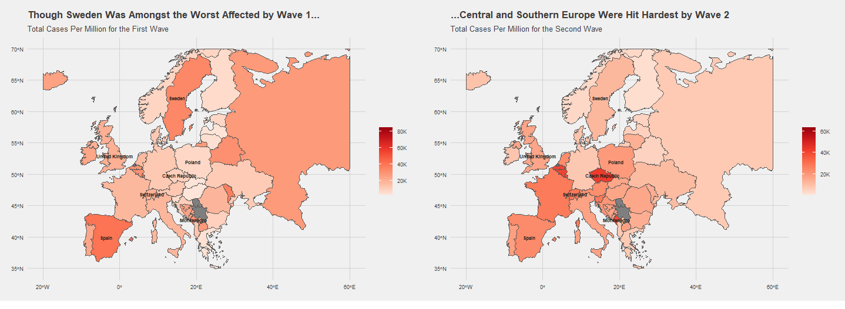
Wave 1: Which European Country had the Most Cases? Wave 1 hit European Countries to a different extent
01.02.2020 – 01.09.2020
01.09.2020 – 27.11.2020

Slide 10
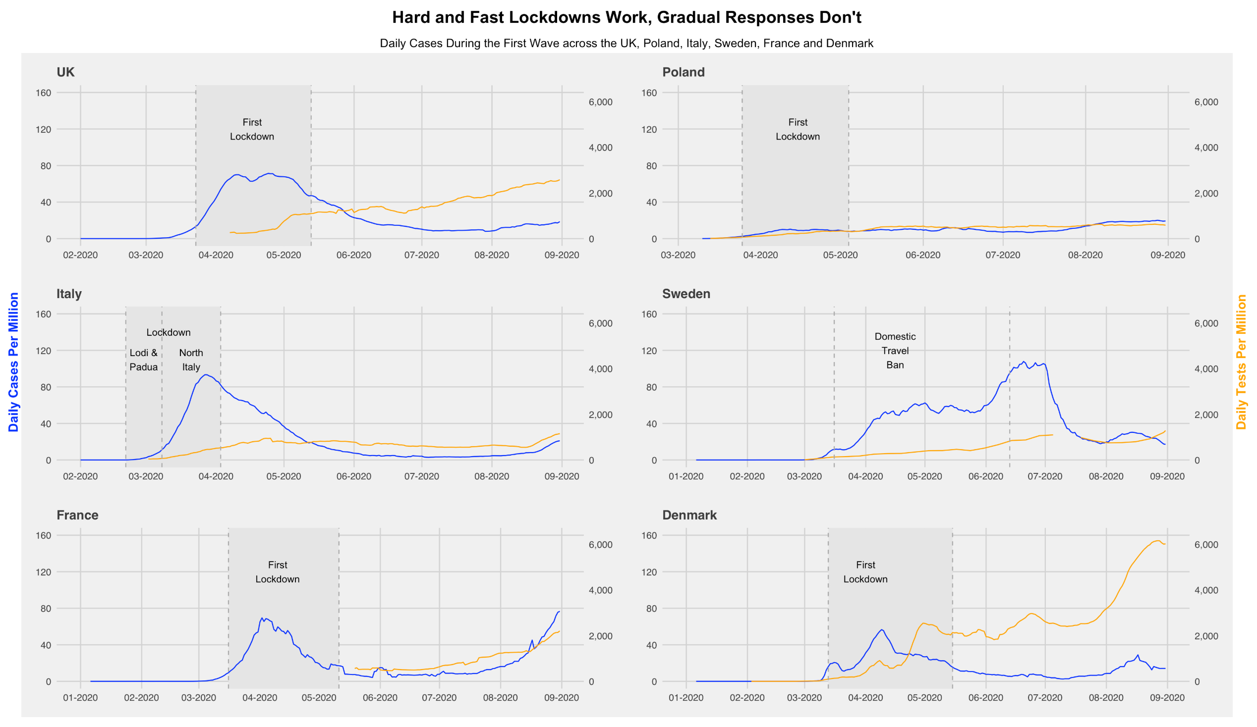



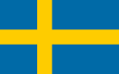


How did European Countries React to Wave 1? What Trend do we see
Late lockdown with slow effect
Fast lockdown
Low testing
Local and strict lockdown
No lockdown -
many cases after loosening restrictions
Late but effective lockdown
Early, hard lockdown, and strong testing

Slide 11
Wave 2: Which European Country had the most Cases? Wave 2 hit European Countries to a different extent
01.02.2020 – 01.09.2020
01.09.2020 – 27.11.2020

Slide 12
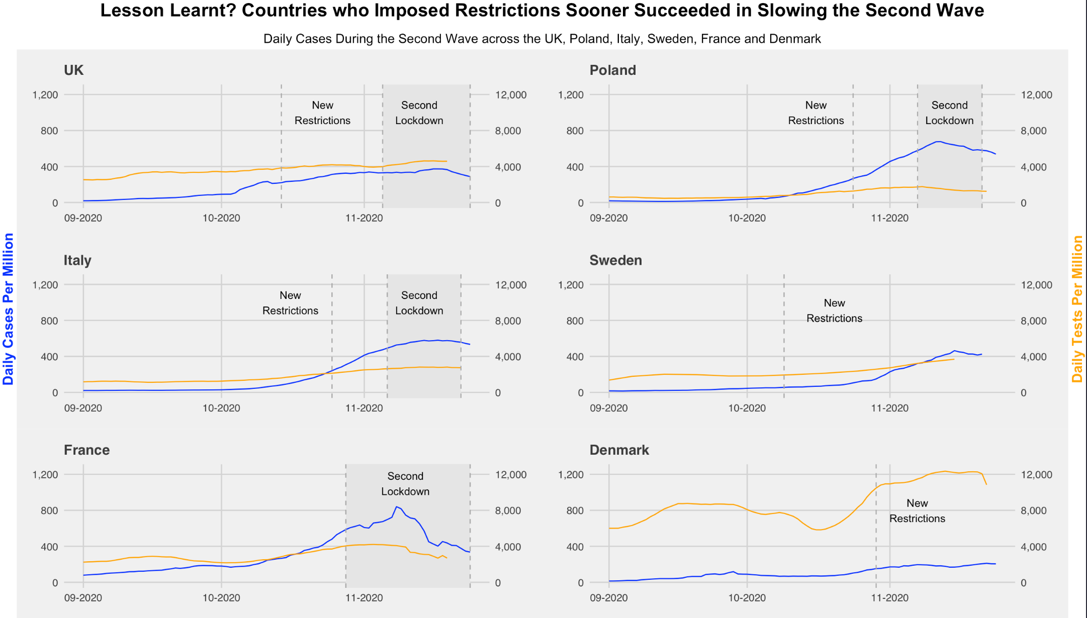
Did Governments Learn from Wave 1? Most countries opted for faster, harder lockdowns – following the Danish example
High testing and later lockdown
Many cases even after lockdown
High cases despite early restrictions
Many cases after loosening restrictions
Later but effective lockdown
Effective testing strategy after successful lockdown

Slide 13
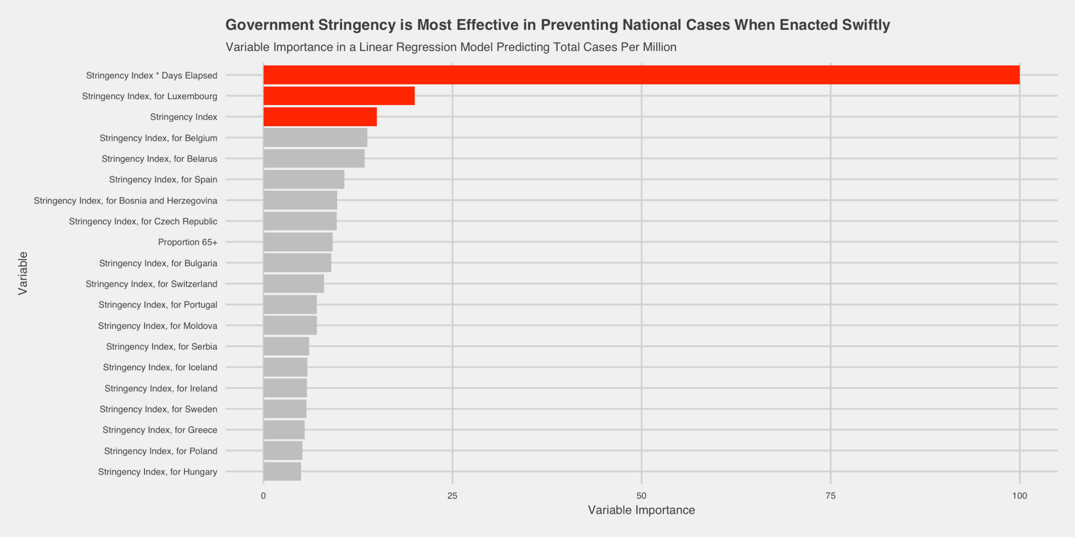
How do Factors Affecting Cases Rank in Importance? Sense check: a linear model empirically supports and enriches our insights
Stringency Index * Days Elapsed
Most important factor
Early lockdowns are considerably more effective
Stringency Index
Of low importance because its effect varies highly between countries
Country Heterogeneity
Stringency measures are clearly not equally important
Total Cases Per Million = 0.0064 – 0.0451* % Aged 65⁺ – 0.783 * Stringency Index + 0.972 * (Stringency Index*Days Elapsed) + B₄ * (Stringency Index*Location), where B₄ is a country-specific coefficient on stringency.

Slide 14
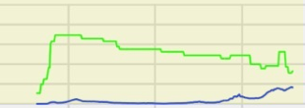
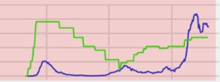
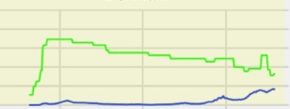
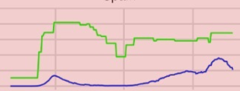


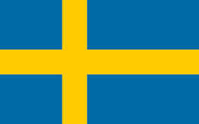




Have They Really Got it Under Control? We sought to understand the differences of COVID - 19 responses amongst European governments and their level of effectiveness
WHERE
EARLY STRINGENCY
WHAT
VARIANCE
have COVID-19 response strategies been successful?
mitigation strategies have been most effective at combatting the virus?
Stable
Indecisive
Effective
Ineffective
WHICH
SPEED
HOW
STRINGENCY
factors are most important in determining the success of mitigation strategies?
does the theorised efficacy of mitigation strategies vary between countries?
Most Important
Less Important
Fast
Slow
Success
Failure
Reflections I Bias due to differences in testing over time and between countries I Reliance on the Stringency index | Improvement via test-adjusted cases

Slide 15
Q&A
Study Group 11

Slide 16
How do Factors Affecting Cases Rank in Importance? Sense check: a linear model empirically supports and enriches our insights
Stringency Index * Days Elapsed
Most important factor
Early lockdowns are considerably more effective
Stringency Index
Of low importance because its effect varies highly between countries
Country Heterogeneity
Stringency measures are clearly not equally important
Total Cases Per Million = 0.0064 – 0.0451* % Aged 65⁺ – 0.783 * Stringency Index + 0.972 * (Stringency Index*Days Elapsed) + B₄ * (Stringency Index*Location), where B₄ is a country-specific coefficient on stringency.

Slide 17
Have They Really Got it Under Control? We sought to understand the differences of COVID - 19 responses amongst European governments and their level of effectiveness
WHERE
WHAT
STABLE
INDECISIVE
EARLY STRINGENCY
have COVID-19 response strategies been successful?
mitigation strategies have been most effective at combatting the virus?
Effective
Ineffective
Denmark’s early and hard lockdown, and France’s strict lockdown both brought cases down rapidly, though lack of testing seems likely to explain much of France’s apparent success.
We identify a pattern between stability of stringency measures (whether high or low) and both cases and deaths: the less indecisive government policy, the lower the spread of cases and deaths. Overconfidence was fatal as Wave 2 approached.
WHICH
FAST
SLOW
HOW
STRINGENCY
factors are most important in determining the success of mitigation strategies?
does the theorised efficacy of mitigation strategies vary between countries?
Most Important
Luxembourg
Belgium
Spain
Czech Republic
Less Important
Poland
Greece
Sweden
Iceland
Success
Failure
Timing is (almost) everything. The sooner stringency measures are taken, the fewer cases and fatalities countries can expect, regardless of how stringent they are.
Stringency seems to matter most for small countries with high population densities (Belgium and Luxembourg), and for the worst hit countries (Czech Republic, Spain) with slow, indecisive responses.
Reflections I Bias due to differences in testing over time and between countries I Reliance on the Stringency index | Improvement via test-adjusted cases

